Slide 1



CUSTOMER SATISFACTION
Goals
The case of Turkish Airline
Results
Overview
Methods
Recommendation
Data Description
Iman Hassan 1905903
Omer Ozsutcu 1906454

Slide 2
Turkish Airlines
Turkish Airline is one of most remarkable Airline services providers.
The company joined the global airline confederation (Star Alliance). (Turkish Airlines, 2019)
It conduct flights to 120 countries all over the world. (Turkish Airlines, 2019)
The Company has 13 subsidiaries, compromising mainly of service provider companies operating in the field of maintenance and overhaul, catering, ground handling and fuel supply. Among these, 3 are directly owned companies and 10 are joint ventures. (Turkish Airlines, 2019)
Methods
Goals
Overview
Results
Data Description
Recommendation

Slide 3
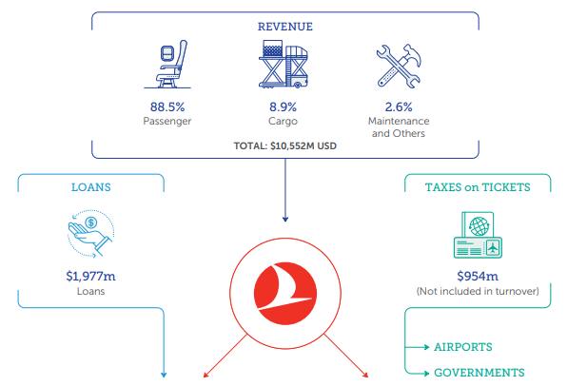
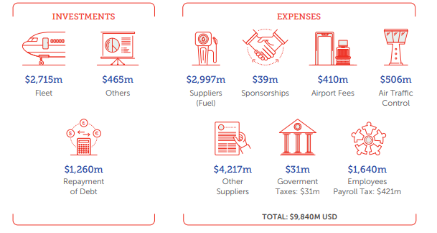
Turkish Airlines
Methods
Goals
Overview
Results
Data Description
Recommendation

Slide 4
Turkish Airlines As a Service based company.
As any service-based company, customer satisfaction and loyalty play significant role in term of the company Revenue.
When firms provide a high quality services and keen to reach beyond the consumers expectation, that will enhance it to gain sustainable competitive advantage in the market.
One of the important management way to improve customers satisfaction and understand the customers’ needs is using SERVQUAL.
SERVQUAL is model that is identifies the gaps between the customers’ expectations and the services provided to them. (Parasuraman et al., 1988)
Methods
Goals
Overview
Results
Data Description
Recommendation

Slide 5
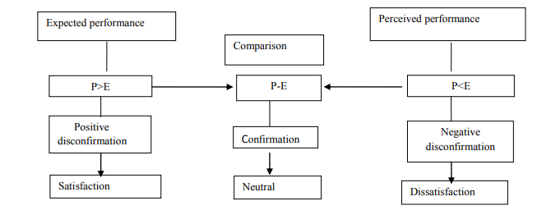
Turkish Airlines As a Service based company.
SERVQUAL
Methods
Goals
Overview
Results
Data Description
Recommendation

Slide 6



Goals
What is the most important factors that affect customer satisfaction
What is the data provide as recommendations
Goals
Methods
Overview
Results
Data Description
Recommendation
What is the most suitable Model to predict customer satisfaction

Slide 7
Data Description
Overall Customer satisfaction
Reservation
Pre-Flight Experience
Onboard Experience
Post-Flight Experience
Additional Services
Internet- Mobile App
Sales Office
Call Center
Connecting flight
Check-in
CIP lounge
Boarding
Cabin
Cabin Crew
Seats
In-Flight Entertainment
In-flight Catering
Goals
Methods
Overview
Results
Data Description
Recommendation

Slide 8
Data Description
Goals
Methods
Overview
Results
Data Description
Recommendation

Slide 9
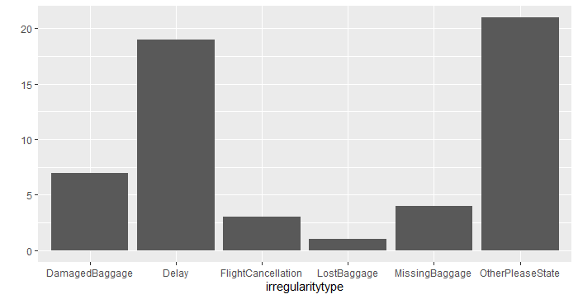
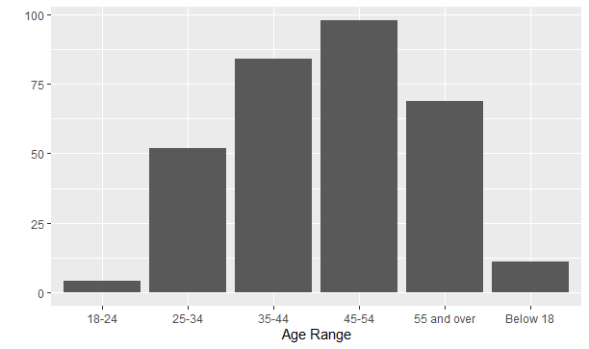
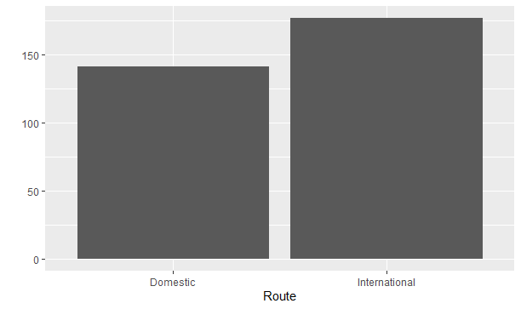
Data Description
Goals
Methods
Overview
Results
Data Description
Recommendation

Slide 10
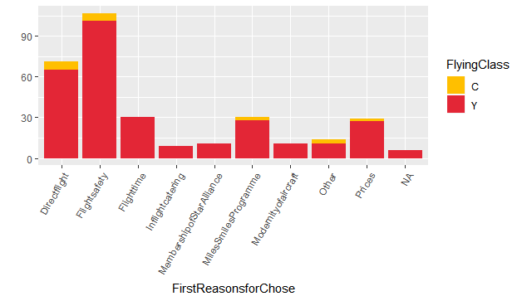
Data Description
Goals
Methods
Overview
Results
Data Description
Recommendation

Slide 11
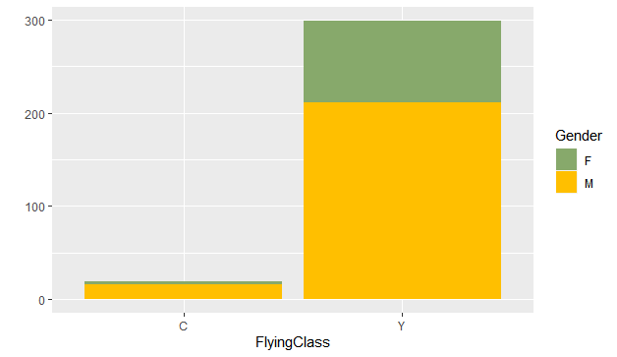
Data Description
Goals
Methods
Overview
Results
Data Description
Recommendation

Slide 12
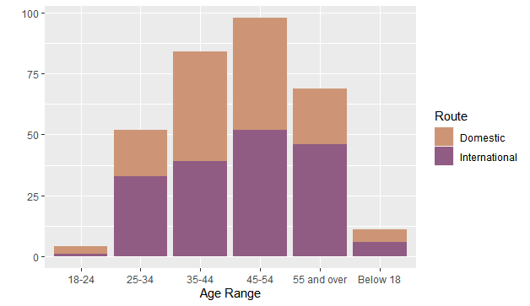
Data Description
Goals
Methods
Overview
Results
Data Description
Recommendation

Slide 13
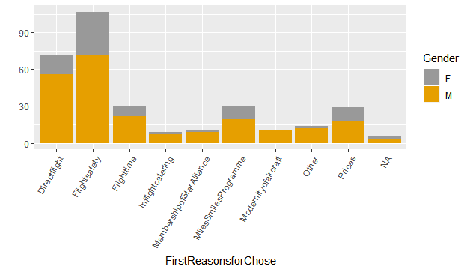
Data Description
Goals
Methods
Overview
Results
Data Description
Recommendation

Slide 14
Methods
Comparing Means
Modeling the Data
Predicting the Data
T.Test
Anova
Logistic Regression
Decision Tree
Divide the data into 70% Train and 30%Test.
Goals
Results
Methods
Overview
Recommendation
Data Description

Slide 15
Questions & Results
The Mean value differences for
Irregularities
Gender
Age Range
Route
Reservation
First Reason To choose Turkish Airlines
Educational level
Goals
Methods
Overview
Results
Data Description
Recommendation

Slide 16

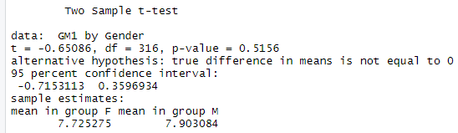
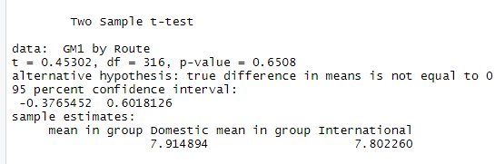
Questions & Results
Are Females more satisfied than Males?
GendarGm1<- t.test(GM1~Gender, var.equal=TRUE)
Goals
Methods
Overview
Results
Data Description
Recommendation
Are International passengers more satisfied than Domestics?
routeGm1<- t.test(GM1~Route, var.equal=TRUE)

Slide 17
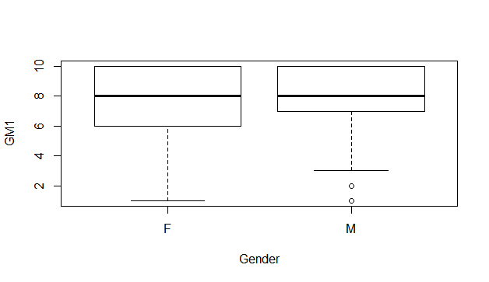
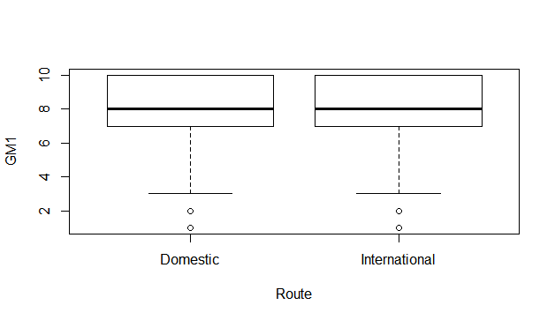
Questions & Results
Goals
Methods
Overview
Results
Data Description
Recommendation

Slide 18
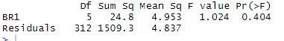
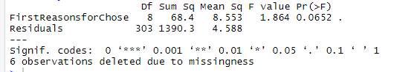
Questions & Results
Is there is a significant difference among different Reservation ways in term of overall satisfaction ?
Reservationtype1<-aov(GM1~BR1)
Goals
Methods
Overview
Results
Data Description
Recommendation
is there is difference in mean values of First reason to choose Turkish Airline in term of overall satisfaction?
Gm1Fst<- aov(GM1~FirstReasonsforChose)

Slide 19
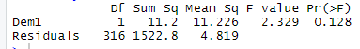
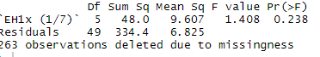
Questions & Results
Is there is difference in mean values of different Education level in term of overall satisfaction?
Dem1Gm1<- aov(GM1~Dem1)
Goals
Methods
Overview
Results
Data Description
Recommendation
Is there is a significant difference among Irregularities in term of overall satisfaction?
irregulaityGM<- aov(GM1~ `EH1x (1/7)`)

Slide 20
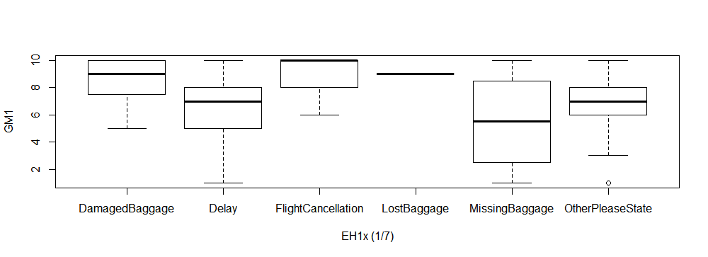
Questions & Results
Is there is a significant difference among Irregularities in term of overall satisfaction?
irregulaityGM<- aov(GM1~ `EH1x (1/7)`)
Goals
Methods
Overview
Results
Data Description
Recommendation
we found out that Delay and Missing Baggage are having less satisfaction level compare to other irregularities.
We decided to create new column to split the irregularities into two (Delay and Missing Baggage =1, others=0)

Slide 21
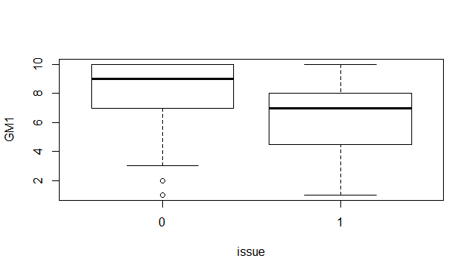
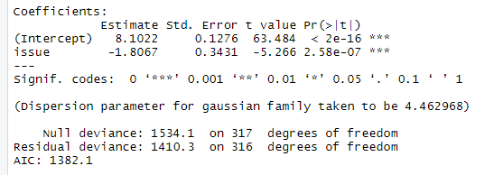
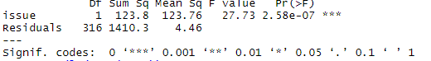
Questions & Results
Is there is a significant difference among Irregularities in term of overall satisfaction?
summary(aov(GM1~issue))
summary(glm(GM1~issue))
Goals
Methods
Overview
Results
Data Description
Recommendation

Slide 22
Questions & Results
What are the most important Factors that affect overall customer satisfaction.
Irregularities
Pre-Flight experience
Onboard experience
Post-Flight experiences
Reservation type.
Goals
Methods
Overview
Results
Data Description
Recommendation

Slide 23
Questions & Results
What are the most important Factors that affect overall customer satisfaction.
Correlation
 | Irregularities | Pre-Flight experience | Onboard experience | Post-Flight experiences
GM1 | -0.284028 | 0.611454 | 0.714373 | 0.440716
Goals
Methods
Overview
Results
Data Description
Recommendation

Slide 24
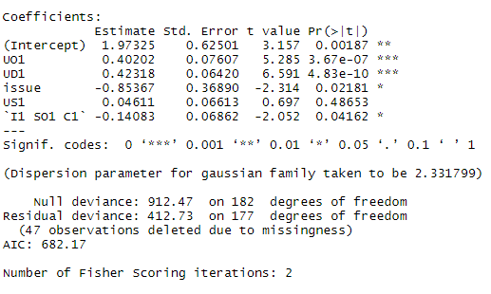
Questions & Results
Overall Customer Satisfaction
Reservation
Pre-Flight Experience
Onboard Experience
Post-Flight Experience
Irregularities
What are the most important Factors that affect overall customer satisfaction.
Goals
Methods
Overview
Results
Data Description
Recommendation

Slide 25
Questions & Results
Overall Customer Satisfaction
Reservation
Pre-Flight Experience
Onboard Experience
Post-Flight Experience
Irregularities
What are the most important Factors that affect overall customer satisfaction.
Goals
Methods
Overview
Results
Data Description
Recommendation

Slide 26
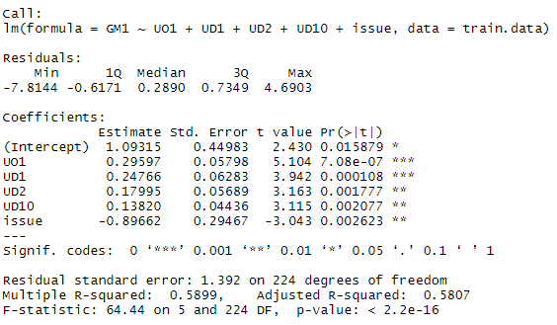
Questions & Results
What are the most important Factors that affect overall customer satisfaction.
Our Final Model
Goals
Methods
Overview
Results
Data Description
Recommendation

Slide 27
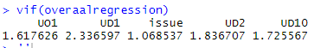
Questions & Results
What are the most important Factors that affect overall customer satisfaction.
Our Final Model – Multicollinearity test
Goals
Methods
Overview
Results
Data Description
Recommendation

Slide 28
Questions & Results
What are the most important Factors that affect overall customer satisfaction.
Our Final Model – Prediction Model
Logistic Regression
Decision Tree
Goals
Methods
Overview
> 1-sum(diag(DT))/sum(DT)
[1] 0.9659091
Results
Data Description
Recommendation
> 1-sum(diag(tabLR))/sum(tabLR)
[1] 0.9886364

Slide 29
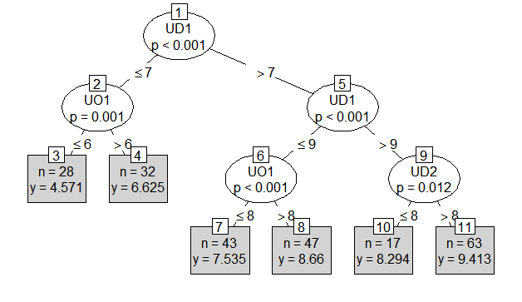
Questions & Results
What are the most important Factors that affect overall customer satisfaction.
Our Final Model – Prediction Model
Logistic Regression
Decision Tree
Goals
Methods
Overview
> 1-sum(diag(DT))/sum(DT)
[1] 0.9659091
Results
Data Description
Recommendation
> 1-sum(diag(tabLR))/sum(tabLR)
[1] 0.9886364

Slide 30
Questions & Results
What are the most important Factors that affect overall customer satisfaction.
Our Final Model
Overall satisfaction ~ Pre-flight + Onboard + Cabin + In-flight catering + issue.
As those are the most significant variables that affect overall satisfaction we should dive into the details of each one of them.
Furthermore, we can conduct a useful recommendations.
Goals
Methods
Overview
Results
Data Description
Recommendation

Slide 31
Questions & Results
Pre-Flight Check-in (All)
Check-in service time
Language Skills of Check-In Staff
Age range – No
Route –No
Gender – No
Plane type- No
Flying Class- No
Age range – No
Route –No
Gender – No
Plane type- No
Flying Class- No
Age range – No
Route –No
Gender – No
Plane type- No
Flying Class- No
Queue Time
Goals
Methods
Overview
Results
Data Description
Recommendation

Slide 32
Questions & Results
Pre-Flight Check-in (counter & CIP lounge)
Interaction of check-in staff
Appearance of the counter
Age range – No
Route –No
Gender – No
Plane type- No
Flying Class- No
Age range – Yes
Route –No
Gender – No
Plane type- No
Flying Class- No
Age range – No
Route –No
Gender – Yes (f)
Plane type- No
Flying Class- No
Staff welcome
Goals
Methods
Overview
Results
Data Description
Recommendation

Slide 33
Questions & Results
Cabin
Sufficient room
Cleanliness of cabin
Age range – Yes
Route –No
Gender – No
Plane type- No
Flying Class- No
Age range – No
Route –Yes (In)
Gender – No
Plane type- No
Flying Class- No
Age range – No
Route –Yes (D)
Gender – No
Plane type- No
Flying Class- No
Cabin Design
Goals
Methods
Overview
Results
Data Description
Recommendation

Slide 34
Questions & Results
In-Flight catering
Flavor of food
Beverages variety
Quality of food
Presentation quality
Age range – No
Route –No
Gender – No
Plane type- No
Flying Class- Yes
Age range – Yes
Route –Yes
Gender – No
Plane type- Yes
Flying Class- Yes
Age range – No
Route –Yes
Gender – No
Plane type- Yes
Flying Class- Yes
Age range – No
Route –No
Gender – No
Plane type- No
Flying Class- Yes
Goals
Methods
Overview
Results
Data Description
Recommendation

Slide 35
Recommendations
The company should focus on the pre-flight experiences and onboard experiences, cabin , and inflight catering.
By increasing the quality delivered by these variables, increase in overall customer satisfaction can be expected. Therefore resulting in increase of company’s revenue.
When the passengers faces problems in term of Delays, missing baggage and others, that indicates that the customers satisfaction will decrease.
Goals
Methods
Overview
Results
Data Description
Recommendation

